Slide 1



Topic Outline
Exploratory Data Analysis (EDA)
3
1
Introduction
Data Cleaning & Preparation
4
Model Training
2
5
Conclusion & Insights

Slide 2



INTRODUCTION

Slide 3


Why?
Crucial factors when making purchasing decisions and planning for activities.
Increase confidence in the promised delivery timeline and receive orders on time to meet our needs and expectations.

Slide 4


Problem Statement
How can we predict time taken for delivery accurately and precisely?

Slide 5
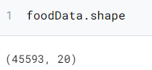



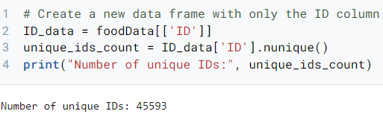

foodData
20 columns
12 numerical
8 categorical
45593 rows
All
unique

Slide 6
Categorical
Numerical
ID
Delivery Person ID
Delivery Person Age
Delivery Person Ratings
Restaurant Latitude
Restaurant Longitude
Delivery Location Latitude
Delivery Location Longitude
Order Date
Time Ordered
Time Order Picked
Time Taken (min)
Weather Conditions
Road Traffic Density
Vehicle Condition
Type of Order
Type of Vehicle
Multiple Delivery
Festival
City

Slide 7
DATA CLEANING & PREPARATION

Slide 8
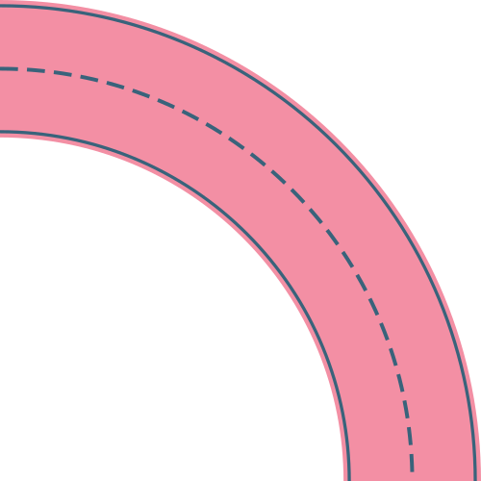

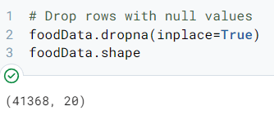
1
REMOVE NULL VALUE IN THE DATASET
CHANGE COLUMN NAMES
2

Slide 9
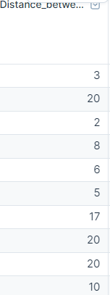
3
INTRODUCE DISTANCE FROM RESTAURANT AND LOCATION LATITUDE AND LONGITUDE
DELETE UNNECESSARY COLUMNS
4

Slide 10
5
RENAME JAM TO VERY HIGH IN ROAD TRAFFIC DENSITY COLUMN
CHANGE ANY STRING TO INTEGER FOR NUMERICAL COLUMNS
6

Slide 11
EXPLORATORY DATA ANALYSIS (EDA)

Slide 12

INDIVIDUAL
VARIABLES
ANALYSIS

Slide 13
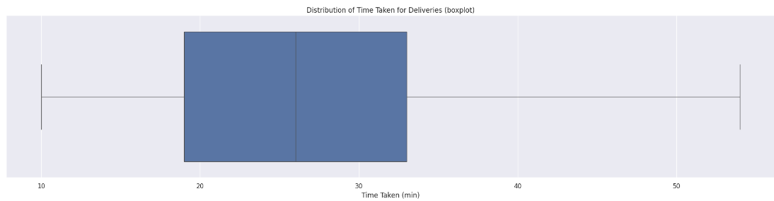

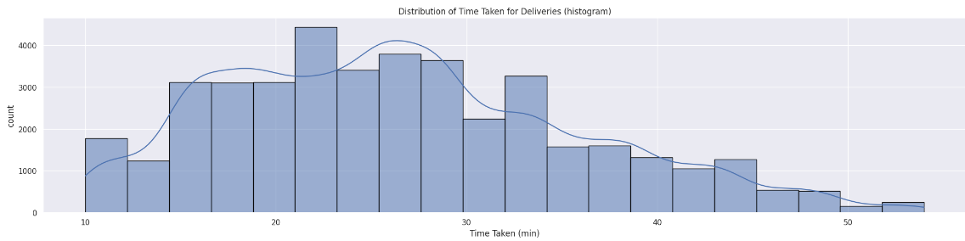
Predicting Variable: Time Taken for Delivery
Absence of outliers
Time taken range from 10min-54min
Insights into central tendency and variability
Helps identify potential bottlenecks or inefficiencies in the delivery process.

Slide 14




Delivery Person
Order Variables
Delivery person Age
Delivery person Ratings
Time Ordered
Time Order picked
Type of order
Environment
Logistical Variables
Weather conditions
Road traffic density
City
Festival
Vehicle condition
Type of vehicle
Distance between restaurant and delivery place (KM)

Slide 15
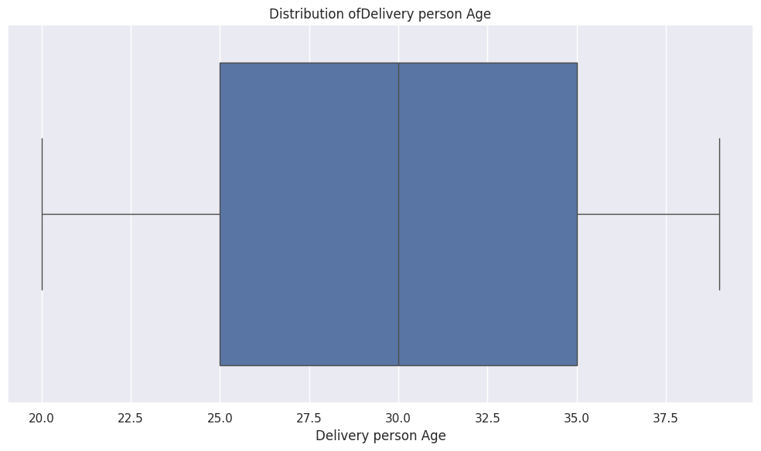
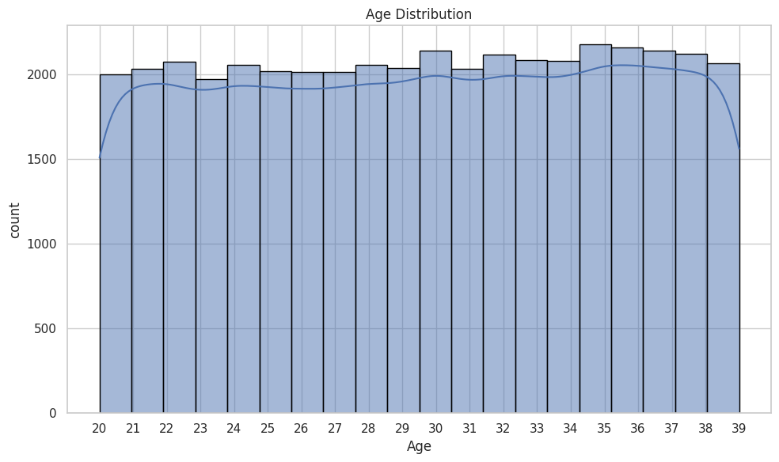

Delivery Person Age
Absence of outliers in delivery person age
Ranging from 20 to 39
Q1 (First Quartile): 25.0
Median = 30.0
Q3 (Third Quartile): 35.0
Minimum value: 20
Maximum value: 39

Slide 16
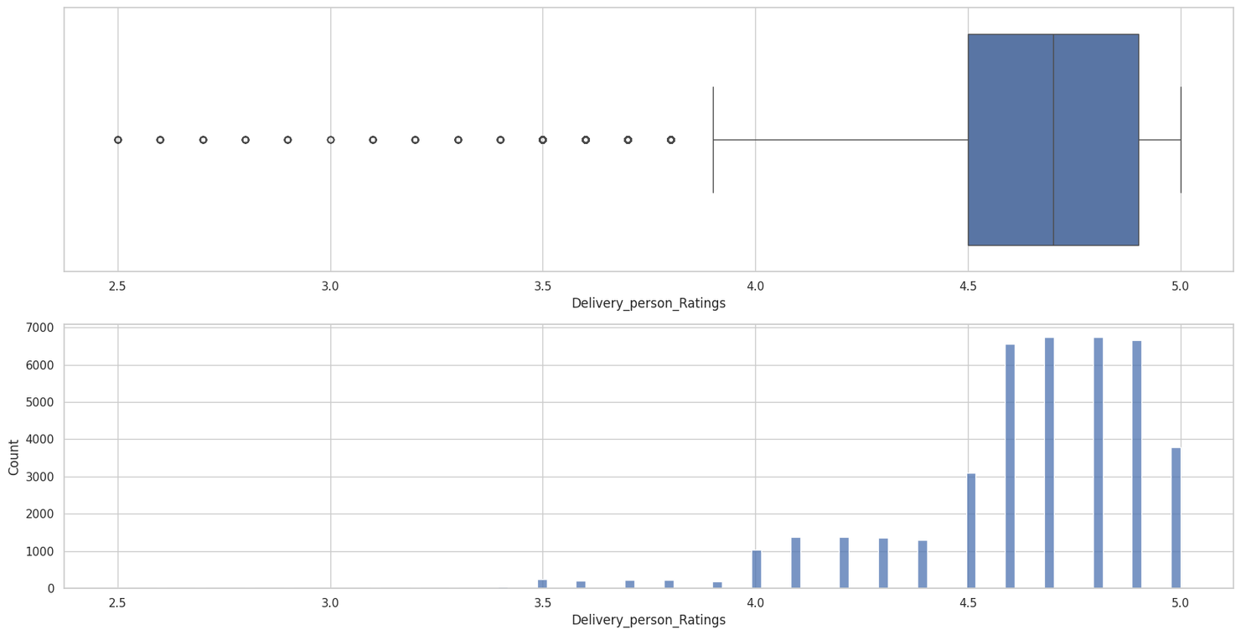
Delivery Person Ratings
Average ratings of delivery person predominantly range from 4.5 to 4.8
Q1 (First Quartile): 4.5
Median: 4.7
Q3 (Third Quartile): 4.9
Minimum value: 2.5
Maximum value: 5.0

Slide 17
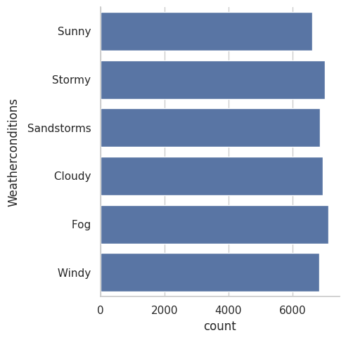
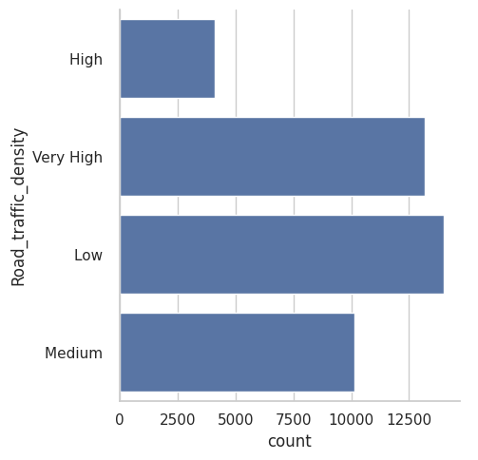



Weather Condition
Road Traffic Density
Diverse weather patterns influenced by geography, seasonality, and local climate.
Fluctuating traffic density, influenced by various factors

Slide 18
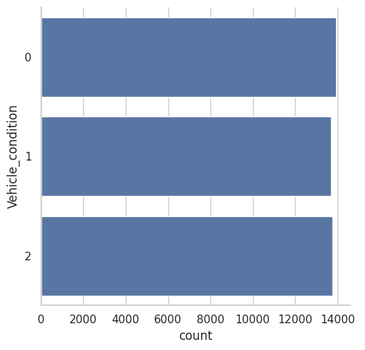

Vehicle Condition
Average counts for vehicle condition

Slide 19

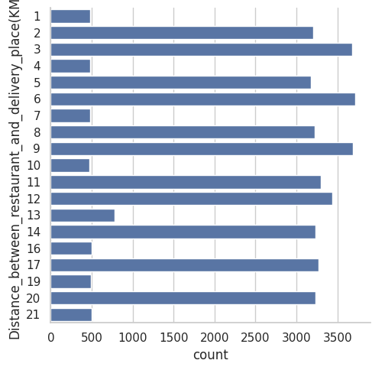
Distance between Restaurant and Delivery Place
Cover distance from 1km to 21km.
Most orders fall within moderate ranges of 2-3km, 5-6km, 8-9km, 11-12km, and 14km.

Slide 20
ANALYIS OF EACH VARIABLES AGAINST TIME TAKEN FOR DELIVERY

Slide 21
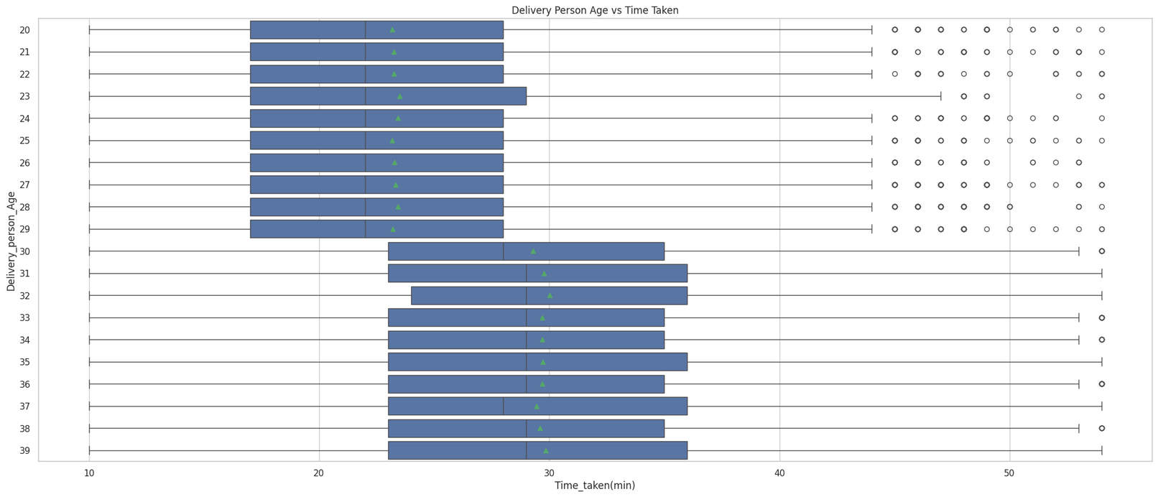


Delivery Person Age
Average delivery time increases with delivery person's age, suggesting older individuals may take longer.

Slide 22
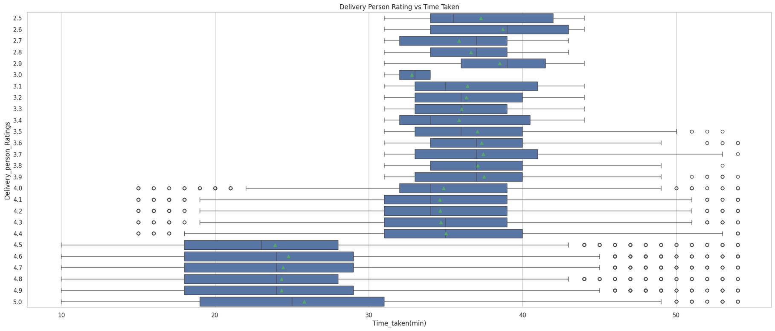
Delivery Person Ratings
Higher-rated delivery persons take shorter time for delivery, suggesting rating could predict delivery time.

Slide 23

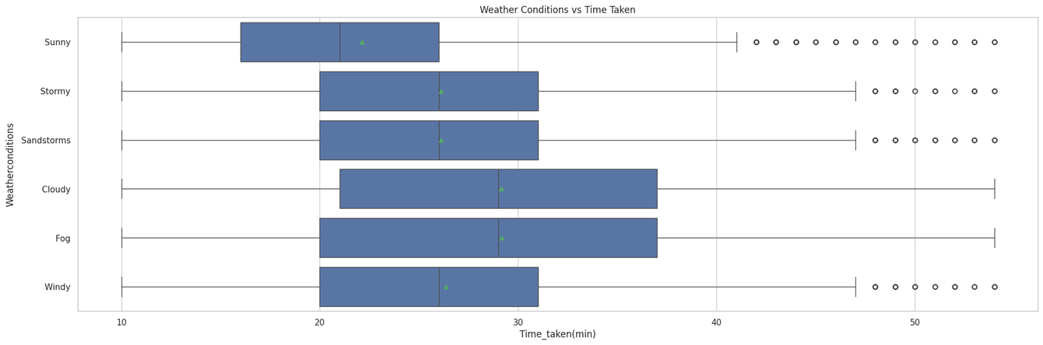

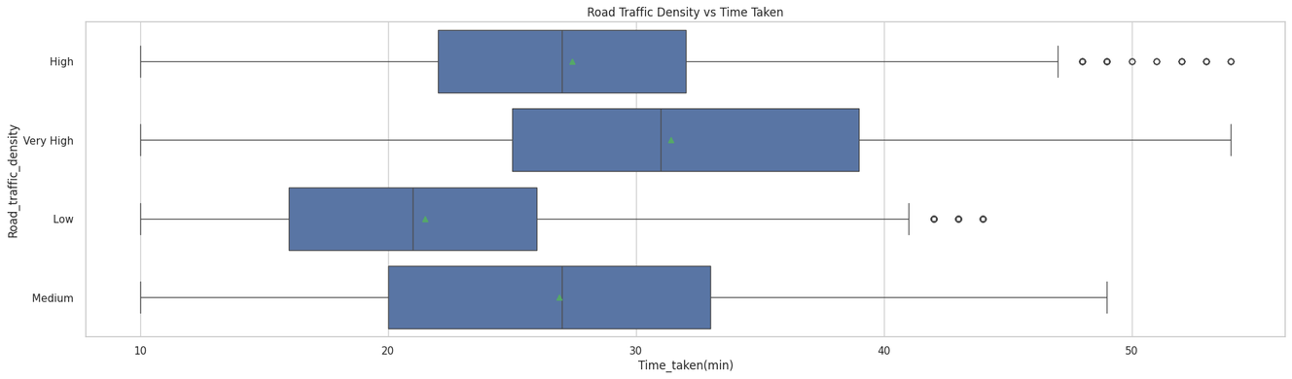
Weather Conditions
Cloudy and Fog weather conditions take a relatively longer time to deliver as compared to others.
Road Traffic Density
Low traffic density -> faster delivery
Very high traffic -> slowest delivery

Slide 24
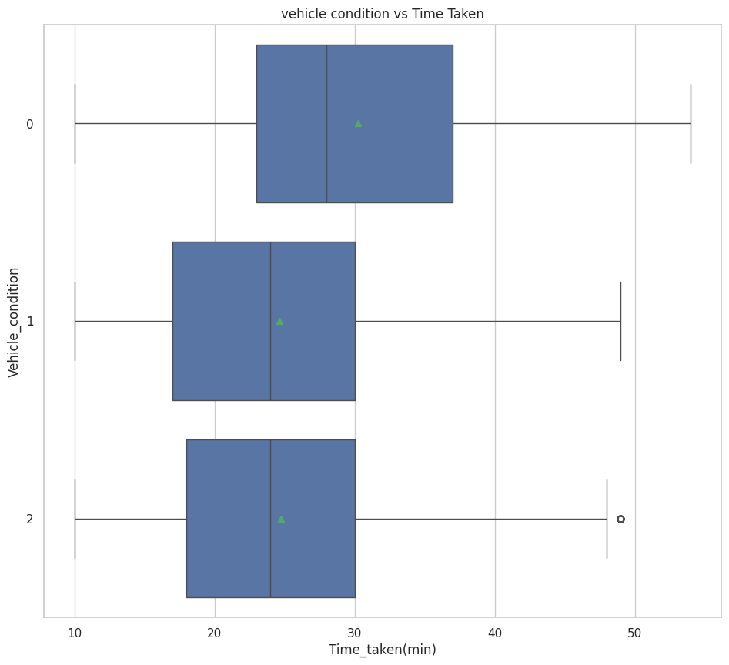


Vehicle Condition
0(bad) takes the longest delivery time
1(good) and 2(very good) almost the same

Slide 25
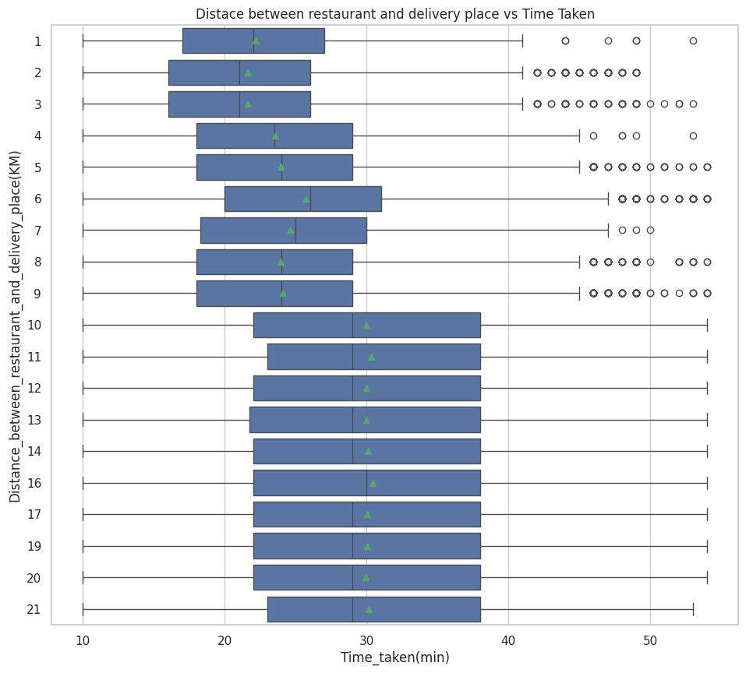
Distance between Restaurant and Delivery Place
In general, the longer the distance, the longer delivery time, suggesting distance may be a good predictor.

Slide 26
DETERMINATION OF TOP 3 NUMERICAL VARIABLES

Slide 27
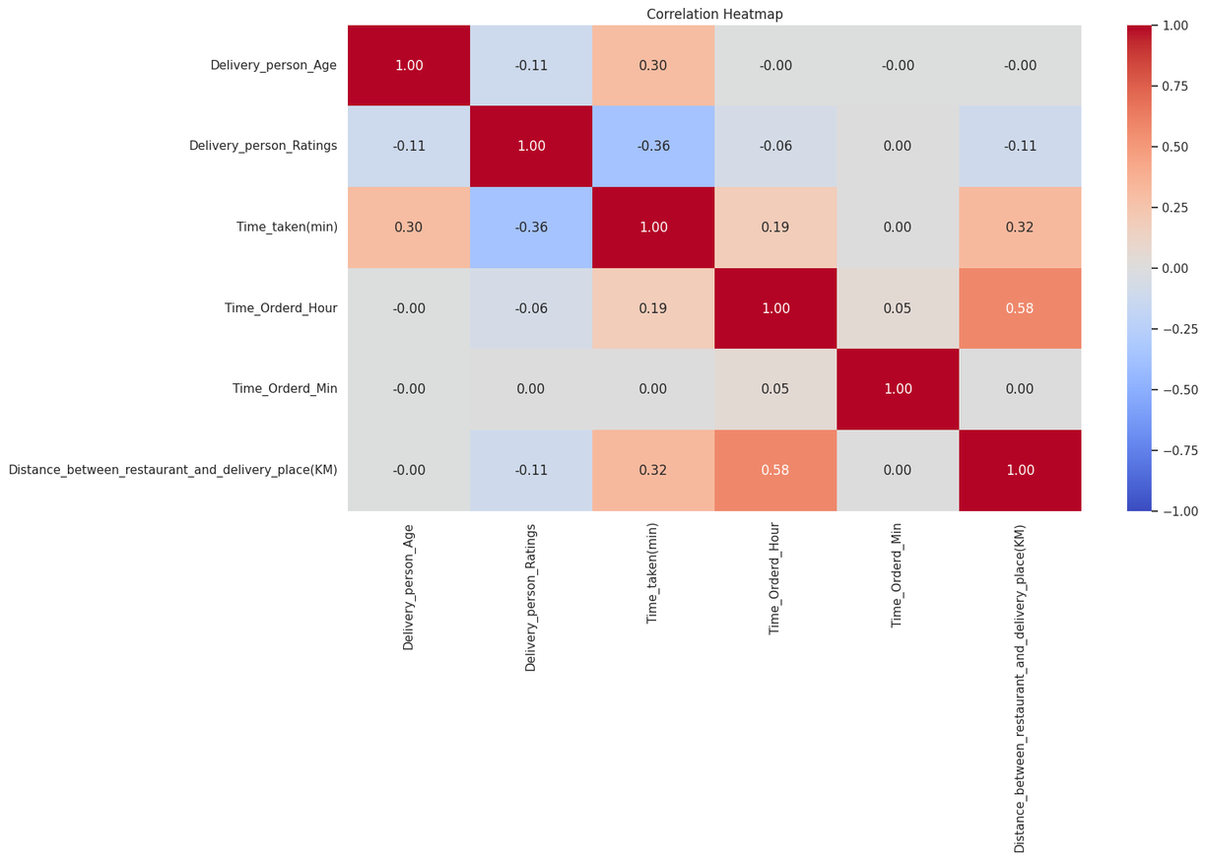

Top 3 Numerical variables
Top 3 predictors for delivery time:
Delivery person age
Delivery person ratings,
Distance to delivery place.

Slide 28
DETERMINATION OF TOP 3 CATEGORICAL VARIABLES

Slide 29
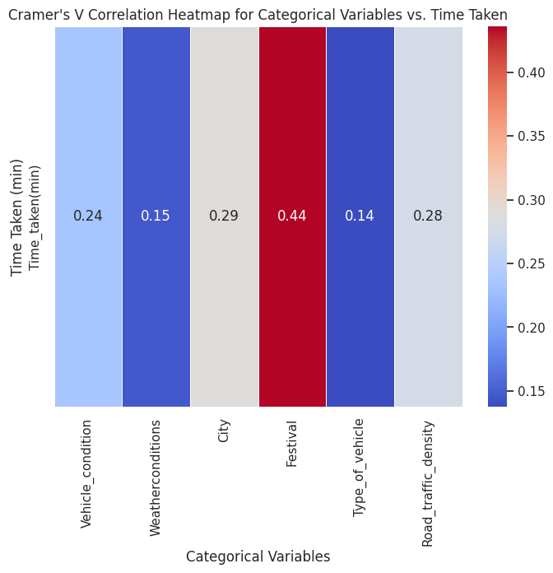
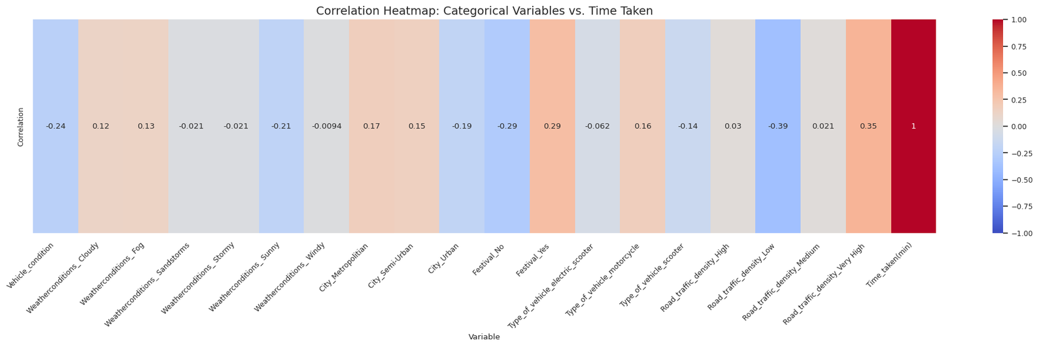

Top 3 Categorical Variables
Cramer’s V
Correlation Heatmap
Both unable to pinpoint key categorical variables affecting delivery time

Slide 30
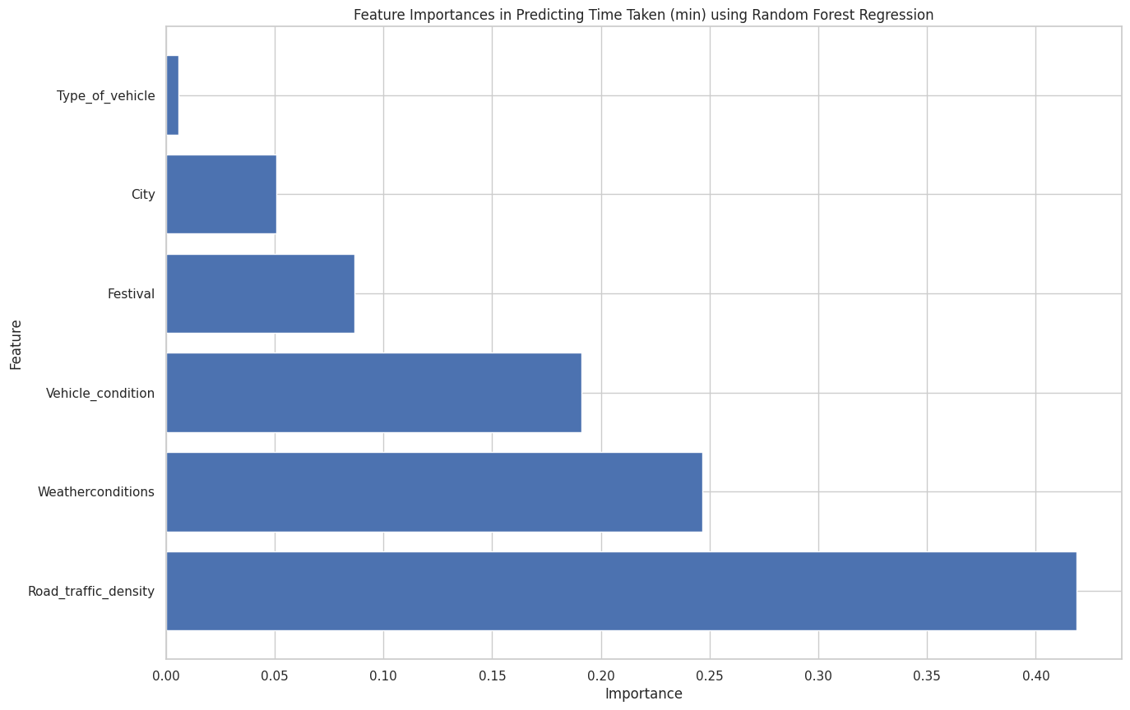

Top 3 Categorical Variables
Random Forest Regression
Random Forest Regression pinpointed key categorical variables affecting delivery time:
Vehicle condition
Weather
Road Traffic

Slide 31
MODEL TRAINING

Slide 32





Modelling Approach
Random Forest Regressor
XGBoost Regressor
Predicts delivery time by averaging the results of multiple decision trees
Utilizes gradient boosting sequential decision tree optimization.
LightGBM Regressor
Uses histogram-based algorithms to speed up training of gradient boosting models
Support Vector Regression
Ensemble Model
Finds the optimal hyperplane that best fits the data points while minimizing errors
Combines the previous 4 models to predict delivery time

Slide 33
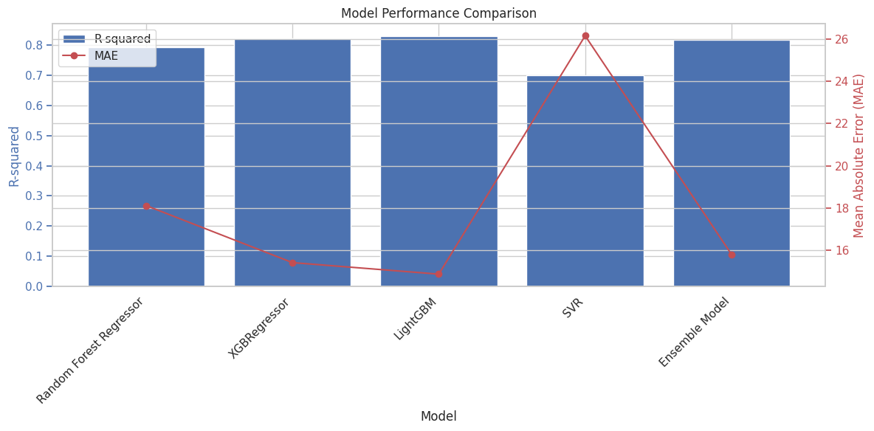
Model Performance Comparison
Models | R-Squared | MSE
Random Forest | 0.7928 | 18.1226
XGBoost | 0.8237 | 15.4241
LightGBM | 0.8299 | 14.8786
Support Vector | 0.7011 | 26.1503
Ensemble | 0.8193 | 15.8114
OPTIMAL MODEL
LIGHTGBM

Slide 34




How to further improve LightGBM accuracy?
Try Hyperparameter Tuning!

Slide 35

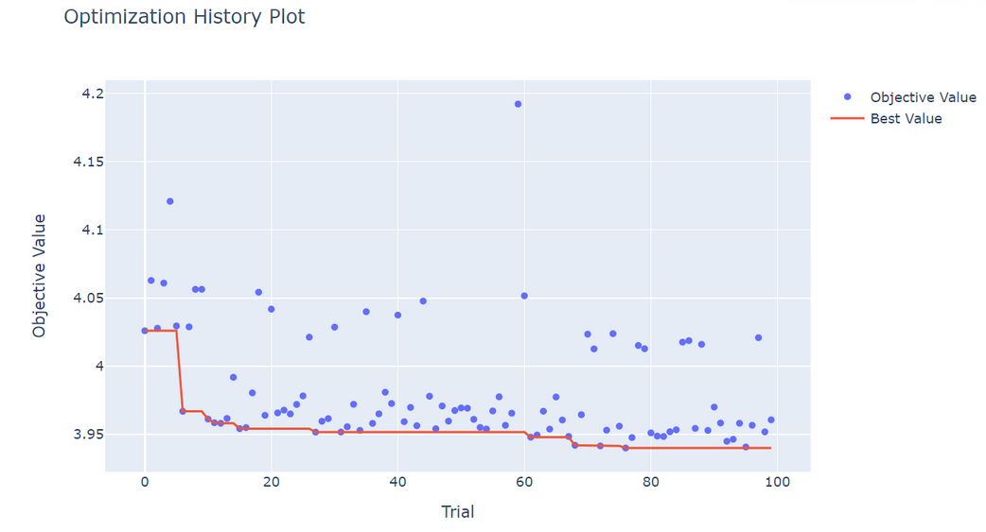
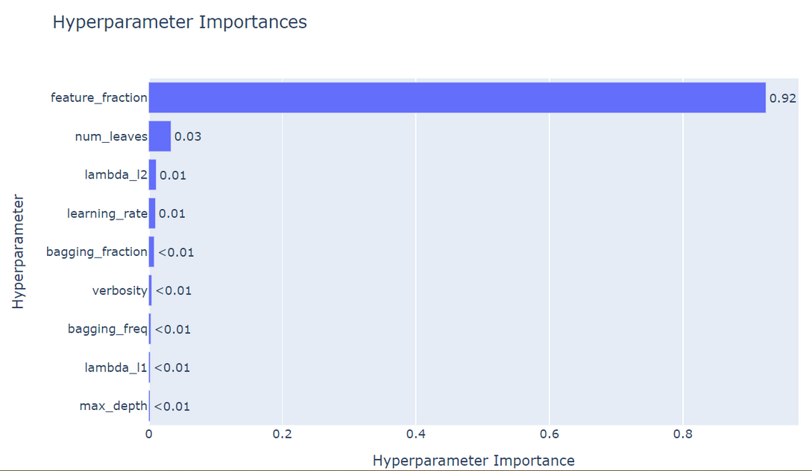

Hyperparameter Tuning
Finding optimal values for Parameters of LightGBM
Tuning Process of Parameters

Slide 36



Hyperparameter Tuning
Untuned LightGBM
Tuned LightGBM
R-Squared: 0.8299
MSE: 14.8786
R-Squared: 0.8225
MSE: 15.5312
Drop in Accuracy!
Untuned model is more accurate

Slide 37
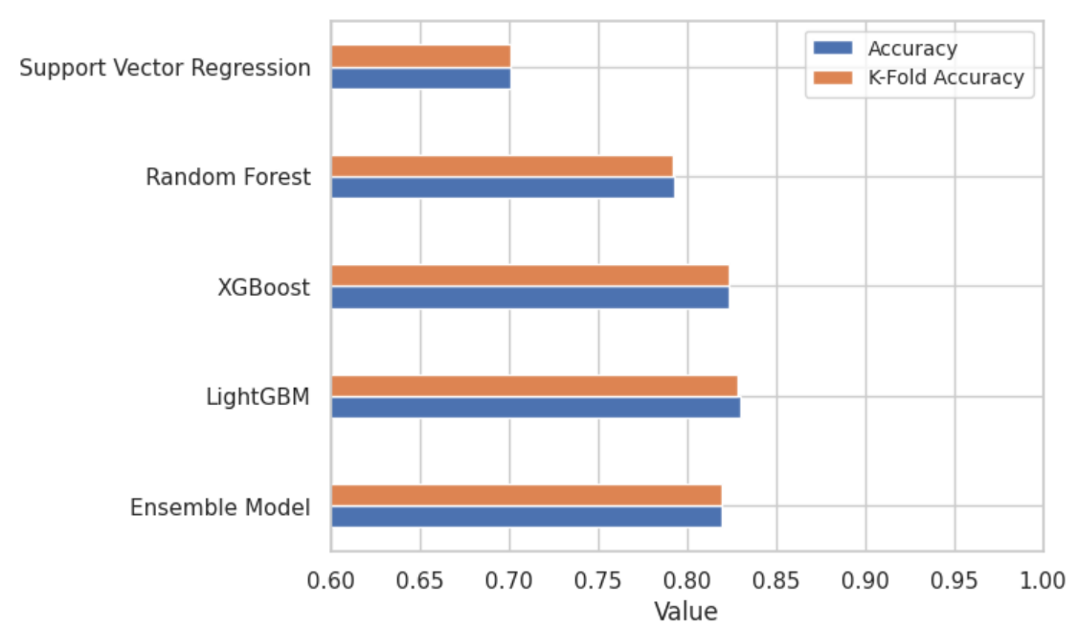

K-Fold
More accurate performance estimate
Overfitting detection
Model Comparison
Proven:
LightGBM = Most accurate

Slide 38
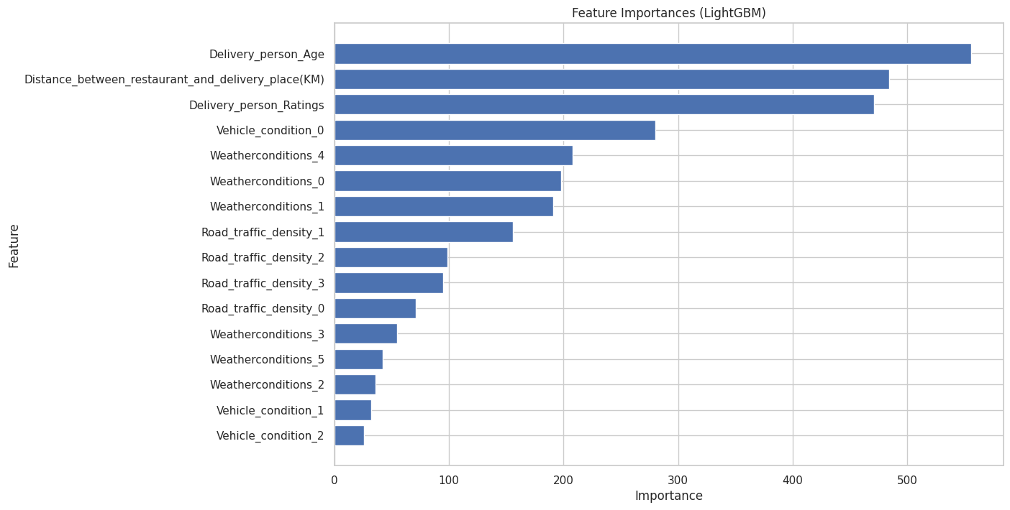

Feature Importance (LightGBM)
Delivery Person Age
Distance
Delivery
Person Ratings

Slide 39
CONCLUSION &
INSIGHTS

Slide 40


Incorporate deep neural networks machine learning techniques
Ensure that the model is robust and scalable
Future
Improvement
Integrate additionals features that could potentially impact delivery time
Incorporate a feedback mechanism

Slide 41



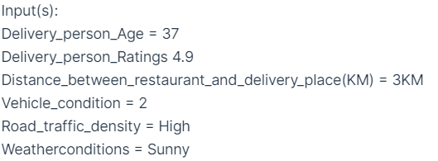
Description
Sample Input
Aim to provide accurate delivery time predictions
Key features: Ability to constantly update its dataset with new user inputs.
Output

Slide 42

Thank You!

